Slide 1
How to cluster a dataset
25/01/2019
Commercial Proposal for:

Slide 2
Agenda
Interactive Presentation
What is clustering
Clustering is easy!
What is wrong?
Next iteration
Cluster analytics
Cluster stability

Slide 3
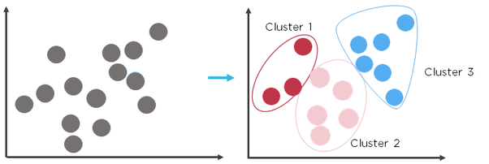
What is clustering
Unsupervised learning
Source: https://www.quora.com/What-is-the-difference-between-k-means-and-hierarchical-clustering

Slide 4
What is clustering
Algorithm
Unsupervised learning
Algorithm
Uses a distance measure (in our case Euclidean) to determine similarity between observations
Goal: create groups of observations, where variance in the group is minimal, variance between groups is maximal
Source: https://www.quora.com/What-is-the-difference-between-k-means-and-hierarchical-clustering

Slide 5
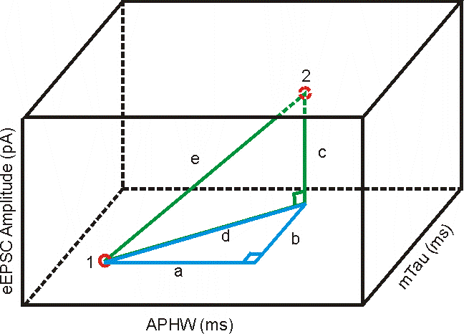
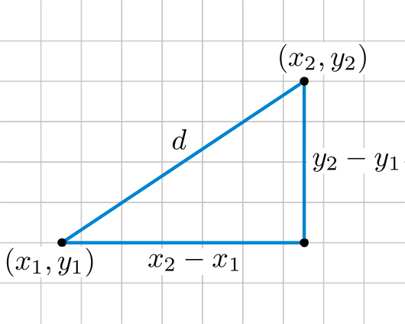
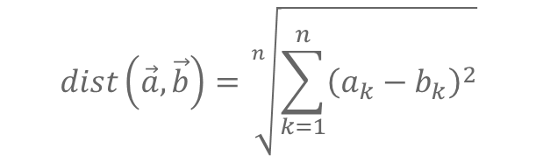
Euclidean Distance measure
Mathematical implications later…
$$dist\left(\vec{a},\vec{b}\right)=\sqrt[n]{\sum_{k=1}^{n}{{\left(a_{k}−b_{k}\right)}^{2}}}$$

Slide 6
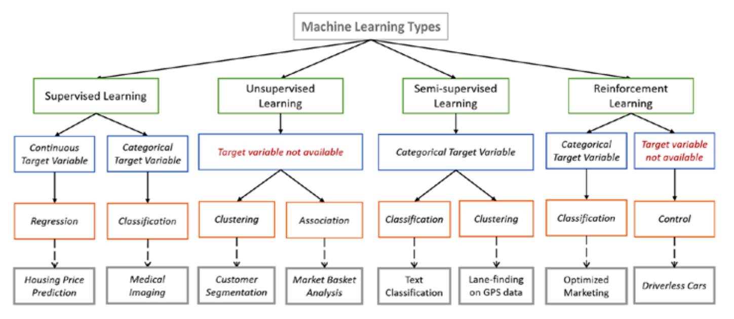
Types of clustering
Different methods
Unsupervised learning
Source: https://en.proft.me/2015/12/24/types-machine-learning-algorithms/

Slide 7
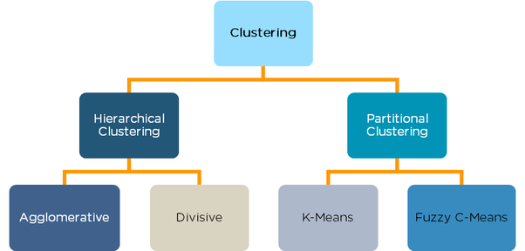
Types of clustering
Different methods
Source: https://www.quora.com/What-is-the-difference-between-k-means-and-hierarchical-clustering

Slide 8
Types of clustering
Different methods
Source: https://www.quora.com/What-is-the-difference-between-k-means-and-hierarchical-clustering

Slide 9
Types of clustering
Different methods
K-Means clustering
Randomly places centroids
Sorts observations into groups
Evaluates target function
Adjust centroids
Repeat until target function no longer improves
Result: membership vector
Hierarchical clustering
Each item is its own cluster
Find the closest (most similar) pair of clusters and merge them, so that now you have one less cluster.
Update distance matrix
Repeat steps 2 and 3 until all items are clustered into a single cluster of size N.
Result: DENDOGRAM
Source: https://www.quora.com/What-is-the-difference-between-k-means-and-hierarchical-clustering

Slide 10
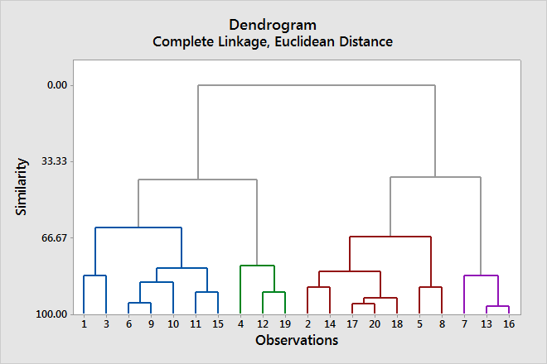
Types of clustering
Different methods
K-Means clustering
Randomly places centroids
Sorts observations into groups
Evaluates target function
Adjust centroids
Repeat until target function no longer improves
Hierarchical clustering
Source: https://www.quora.com/What-is-the-difference-between-k-means-and-hierarchical-clustering

Slide 11
Our clustering example
Algorithm: K-means
Goal: Finding Patterns, NOT classification
Attention: there are better methods available for classification!
Dataset: Credit Card holder usage behaviour
Business Case: find behavioural patterns using clustering to adopt marketing strategy

Slide 12
Summary
The steps of clustering
Step 1: Skewnesss analysis
Step 2: Log appropriate columns
Step 3: Standardize all columns
Step 4: Dimensionality reduction
Step 5: Silhouette and separation analysis
Step 6: Interpretation

